Slide 1
IBM Business Resiliency Services IBM Cloud Resiliency Orchestration
First Last name | IBM Job Title
Location | Date

Slide 2
Seller Guidance -- Delete this slide prior to presenting
IBM Cloud Resiliency Orchestration
Do not send a soft copy of this presentation directly to clients; if necessary share a PDF or hardcopy with them
Note:
Slide no. 16, 17 & 18 is for deep dive presentation, you may remove them if you do not intend using them.

Slide 3





IBM Cloud Resiliency Orchestration
As everyday users of technology, we expect products and services to make our lives more convenient
Customers seek experiences to be more:
Easy to use
Personal
Secure
Empowering
Always on

Slide 4





In a business environment where data grows exponentially and analytics tie directly to consumer satisfaction, businesses cannot tolerate downtime.
IBM Cloud Resiliency Orchestration
Average total cost of a data breach in 2018 was USD 3.86 million¹
NCEI says, Global Disaster Costs in 2018 estimated at USD 91 billion ²
Evolving regulations increase continuity and disaster recovery challenges³
Digital transformation is a business imperative: 60% of organizations will have embarked on a digital transformation journey by 2020⁴
Disruption with hybrid cloud: 56% of multi-cloud maestros expect that, by
2021, most new apps will be built on the cloud⁵
Source 1: Ponemon Institute - 2018 Cost of Data Breach Study: Global Overview
Source 2: https://www.ncdc.noaa.gov/billions/
Source 3: Evolving regulations increase continuity and recovery challenges: GDPR, ISO, HIPPA, Data Protection Directive, etc. have stringent requirements for backup, availability and recovery
Source 4: IDC, Five Key Technologies for Enabling a Cyber-Resilience Framework, 2018
Source 5: Assembling your cloud orchestra: A field guide to multicloud management– IBM IBV Study, 2018

Slide 5

IBM Cloud Resiliency Orchestration
Every Second Counts!
Achieving continuous business operations requires resilience across all business-critical processes, workflows, people, technology and policies.
The longer it takes to recover critical applications, the greater is the impact on the business.

Slide 6




Hybrid is the new norm. Enterprises are adopting hybrid cloud to meet changing business requirements and deliver better customer experience.
IBM Cloud Resiliency Orchestration
Hybrid clouds are designed to enable the enterprise to be more:
Adaptive and agile
Value-driven
Cost-effective
PRIVATE CLOUD
ON-PREMISES INFRASTRUCTURE
PUBLIC CLOUDS

Slide 7


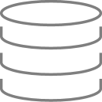


While hybrid cloud can provide agility and flexibility to the enterprise, it can also increase the complexity of backup and recovery environments.
IBM Cloud Resiliency Orchestration
Hybrid architectures can become difficult to integrate, monitor, manage, secure and protect given the wide range of sources where workloads can originate.
IBM manages recovery for workloads coming from any location into your chosen recovery location.
PUBLIC CLOUD
PUBLIC CLOUD
PRIVATE CLOUD
PRIVATE CLOUD
RECOVERY
ON PREM
ON PREM
3RD PARTY DATA CENTER
3RD PARTY DATA CENTER
IBM RESILIENCY CENTER

Slide 8








Business resiliency by design
IBM Cyber Resilience
IBM Business Resiliency Services combines proven business continuity and disaster recovery methodologies with cloud-based technologies to deliver end-to-end enterprise resiliency across hybrid, multiplatform IT environments
IBM Cloud Resiliency Orchestration
Strategy and vision
IBM Cloud Resiliency Consulting Services
IBM Cloud Resiliency Orchestration Consulting Services
IBM Resiliency Consulting Services
IBM Work Area Recovery Services
Organization
IBM Managed Continuity & Recovery Services
IBM High Availability / GDPS Services
Processes
IBM Resiliency Disaster Recovery as a Service (DRaaS)
IBM Resiliency Orchestration Software
IBM Resiliency Services Framework
IBM Backup as a Service
(BaaS)
Cloud Resiliency Application & IT Discovery
Applications
IBM Resiliency Services Framework
Legend:
IBM Data Center Infrastructure Management
Project-based services
Data
Cloud/project-based services
IT Infrastructure
Advisory services (cloud, traditional, hybrid)
IBM Data Center Operations & Mgmt
IBM Site, Facilities, & Data Center Services
Business resiliency Software
Facilities
Managed or hosted services
Managed services (cloud/XaaS)

Slide 9
Orchestration is necessary to deliver a consistent and predictable disaster recovery outcomes
IBM Cloud Resiliency Orchestration
Orchestration
Creating an intelligent workflow comprised of individual automated actions with an awareness of the entire process
Orchestration sits higher in the stack than automation, overseeing the entire process and ensuring the coordination of all required activities
Automation
Codifying a set of manual steps via the creation of scripts that drive singular actions at independent component levels

Slide 10
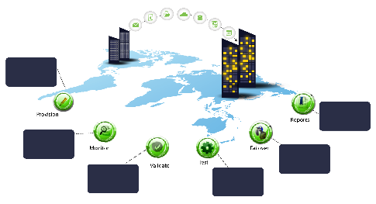
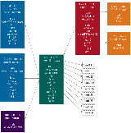
IBM Cloud Resiliency Orchestration with optional consulting and application and IT discovery services can help transform your DR.
IBM Cloud Resiliency Orchestration
IBM Cloud Resiliency Orchestration Consulting
Orchestration Readiness Assessment: Examines 10 areas essential to orchestration and determines level of readiness to migrate
Application Dependency Analysis: Identify critical application dependencies for recovery/restart workflows and procedures
Resiliency Program Management: Manage development of recovery workflows, test exercise coordination and overall DR program management
Deploy best
practices DR
workflow
Compliance
& deviation
reports
Real-time
RPO & RTO
Automated
application
recovery
“Pre-Flight”
checks
Out-of-box
Switchover
& switchback
IBM Cloud Resiliency Orchestration
The service combines automation and analytics for faster, more cost-effective disaster recovery to help keep daily business operations running and to proactively avoid disruptions.
Offering with managed services
Dashboard to view status
Application and IT Discovery
Cloud Resiliency Application and IT Discovery helps automate the discovery process of logically segmenting the infrastructure.
Multilevel server dependencies
Faster and more accurate than manual grouping techniques

Slide 11
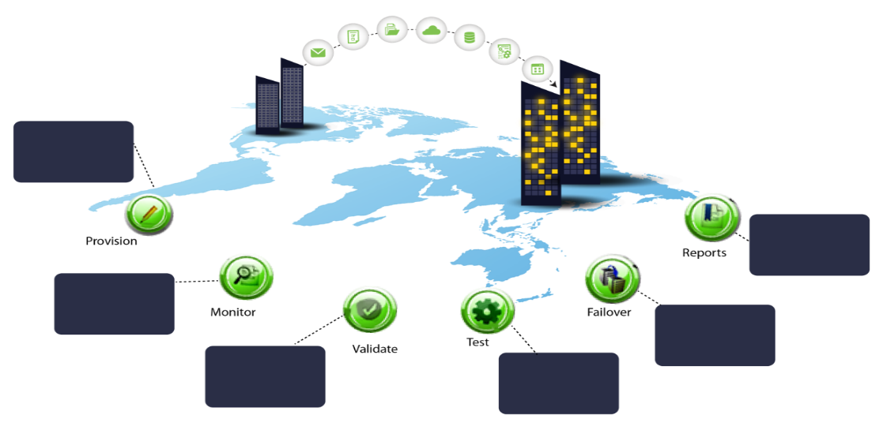
IBM Cloud Resiliency Orchestration provides not only automation but also lifecycle intelligence for your DR environment.
IBM Cloud Resiliency Orchestration
IBM Resiliency Disaster Recovery as a Service features a management solution for aligning DR infrastructure and capabilities with recovery time and recovery point objectives (RTO/RPO).
This service combines the monitoring, reporting, testing, and workflow automation capabilities of complex IT infrastructure in a scalable manner.
The unified DR management solution delivers real-time DR-readiness validation and offers clear business and operational advantages.
The service leverages IBM’s 50 years of experience in the DR business and reliable 24x7 service delivery support.
Reduced DR test time
Reduced resources required for application failover and recovery
Deploy best
practices DR
workflow
Compliance
& deviation
reports
Real-time
RPO & RTO
Automated
application
recovery
Reduced dependency on experts
“Pre-flight”
checks
Out-of-box
switchover
& switchback
Features
Orchestration
Processes, applications, services
Heterogenous
Technology blocks
Automation
Replication – data movers
Point-to-point
Scripts/tasks
DR Management
Monitoring dashboards
Reporting, notifications
Integration
Notes:
IBM Cloud Resiliency Orchestration offers disaster recovery monitoring, reporting, testing and workflow automation capabilities of complex hybrid cloud environments in a scalable, easier-to-use solution built on industry standards. The service combines automation and analytics for faster, more cost-effective disaster recovery to help keep daily business operations running and to proactively avoid disruptions that lead to lost revenue, brand damage and dissatisfied customers.
From a cost perspective the new service will enable better automation of server and application processes, resulting in a more timely DR deployment and exercise process. With the help of the dashboard, many of these tasks will be managed automatically with complete transparency to the customer.
Since orchestration serves to link automated processes across platforms and clouds, there is an increased confidence by the customer to respond quickly to DR events, possibly with a lower requirement for manual intervention and high-level human expertise.
Finally, the quality of the customer’s DR environment improves overall, due to the tool’s consistent ability to spot potential issues and control by the customer to remediate these issues via the automated dashboard.
Value drivers:
Accelerated revenue growth in DR orchestration and through Geo expansion
Additional revenue opportunities in DR and IT Consultancy and GBS
Solution can run on AWS and is intended to run on SoftLayer and can be leveraged for both Cloud units and GTS clients

Slide 12
IBM Cloud Resiliency Orchestration enhances standard technology-run approach for more efficient RTO/RPO in hybrid or non-hybrid environments.
IBM Cloud Resiliency Orchestration
From:
To:
Benefit
Minimal RTO and RPO visibility except during tests/drills
Dashboard for continual monitoring and predictions of RTO and RPO
Reduced risk and increased visibility
Manual, error-prone operation of DR processes and run-books
Intelligently automated run-books and processes with predefined patterns for efficient implementation
Simplified and accelerated DR process
Complex approaches resulting in longer recovery times and resource intensity
Simplified solution using 450+ recovery automation library patterns reducing the recovery times and resources
Reduced deployment time, recovery time and operating costs
Manual DR testing/drills
Using technology to orchestrate automated test plans and failovers
Simplified DR testing exercises
Traditional DR focused at IT infrastructure level only
Managing DR and resiliency at the business process and application level through intelligent workflow management
Increased availability of business applications

Slide 13






IBM Cloud Resiliency Orchestration – delivery options
IBM Cloud Resiliency Orchestration
IBM Global Command Center
Production Datacenter
On-premises/IBM Cloud/AWS
Disaster Recovery Datacenter
On-premises/IBM Cloud/AWS
Orchestration
Firewalls
Internet
Orchestration
Server
Site Controller
Server
Replication
Link
Site Controller
Server
Orchestration
Server
Secure VPN
VM
VM
VM
VM
Production Servers and Storage
DR Servers and Storage
Orchestration server and site controller server at primary and DR site Three options: on-premises, IBM Cloud and AWS
IBM Global Command Center provides monitoring and management. Local subject matter experts and project management services

Slide 14

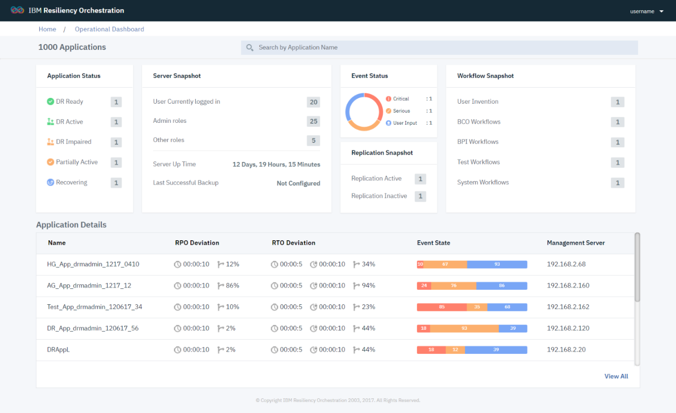
Clear dashboards and reports help you continuously monitor your enterprise resiliency program more effectively
IBM Cloud Resiliency Orchestration
Executive dashboard
Application-wise summary of recovery-readiness
Events requiring attention
RPO and data lag meter
Recovery workflows that are active

Slide 15

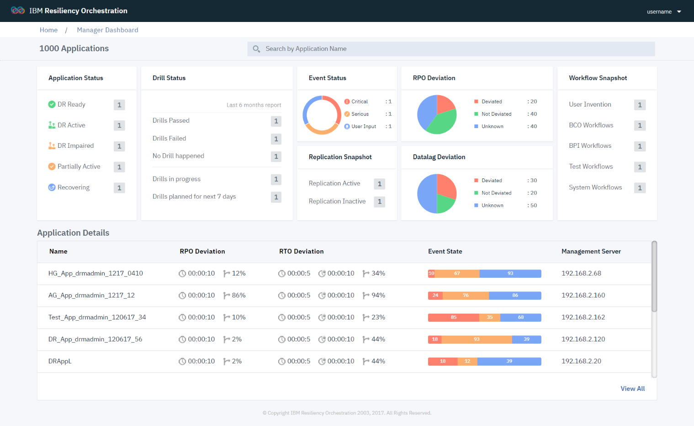
DR administrators can visually and accurately understand the RTO via the solution
IBM Cloud Resiliency Orchestration
DR administrator dashboard
Database logs position
Dashboard with monitoring, alerts and reporting
Disaster recovery solution health and data RPO and RTO service level agreements

Slide 16
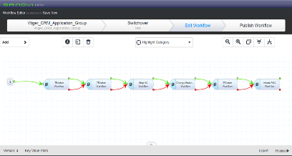
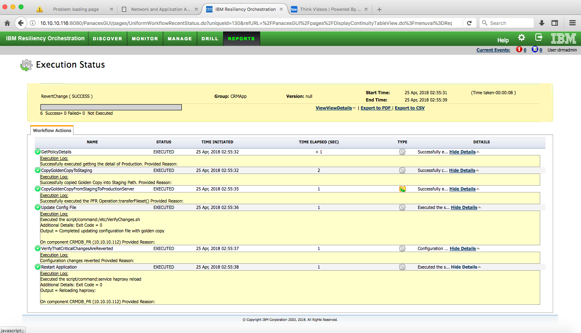
Automation engine for easy management of DR workflows
IBM Cloud Resiliency Orchestration
DR workflow management engine
Quick designing of intelligent workflows
Rapid scaling up of DR
Continuously improving workflows
Versioning and publishing
Simulation
DR test scenarios
Dry run

Slide 17
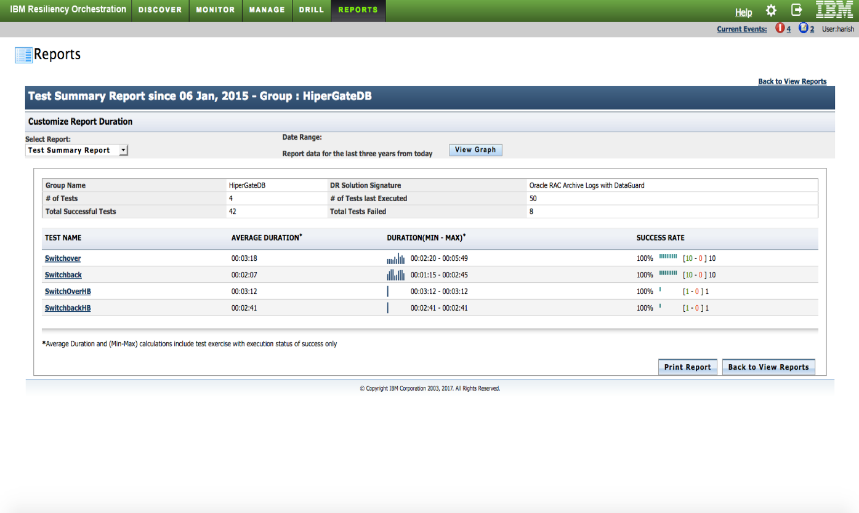
IBM Cloud Resiliency Orchestration
Audit and compliance reports at the click of a button
Tamper-proof evidence of control
Comprehensive DR test reports within seconds

Slide 18
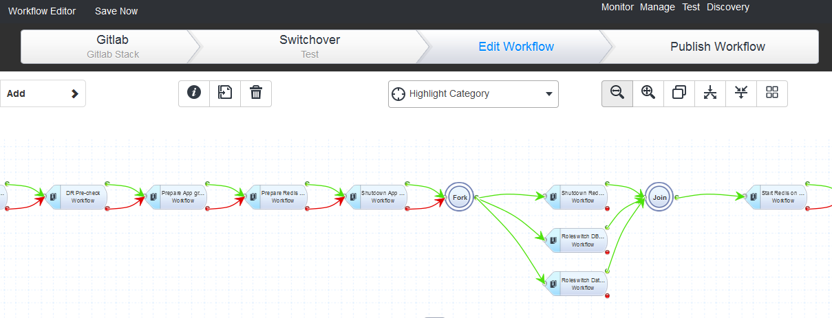
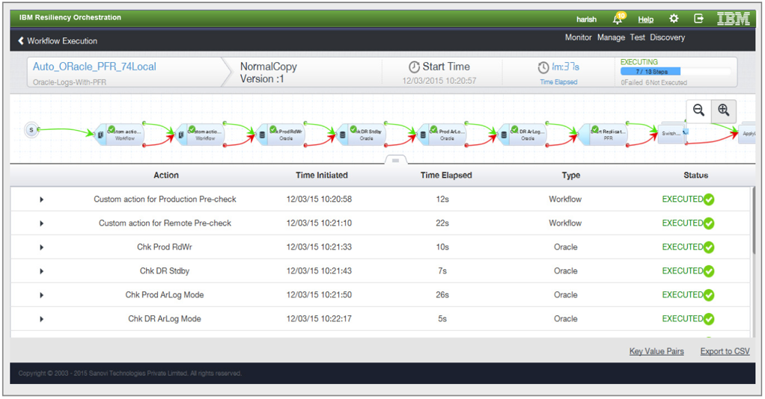
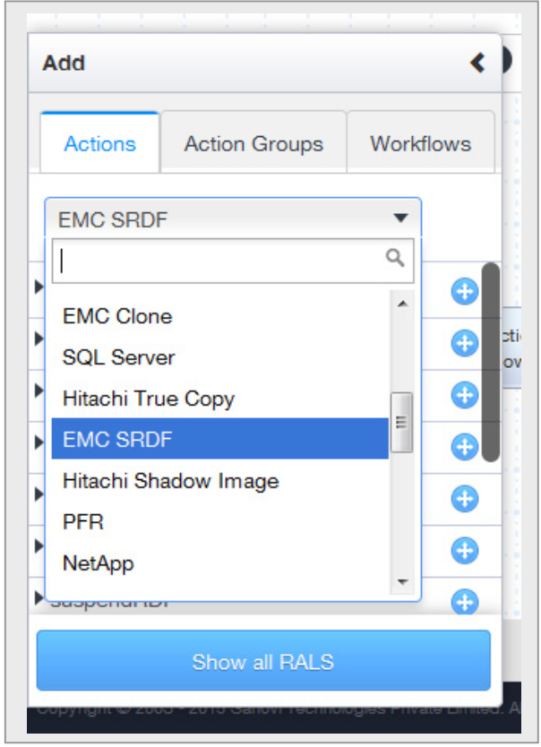
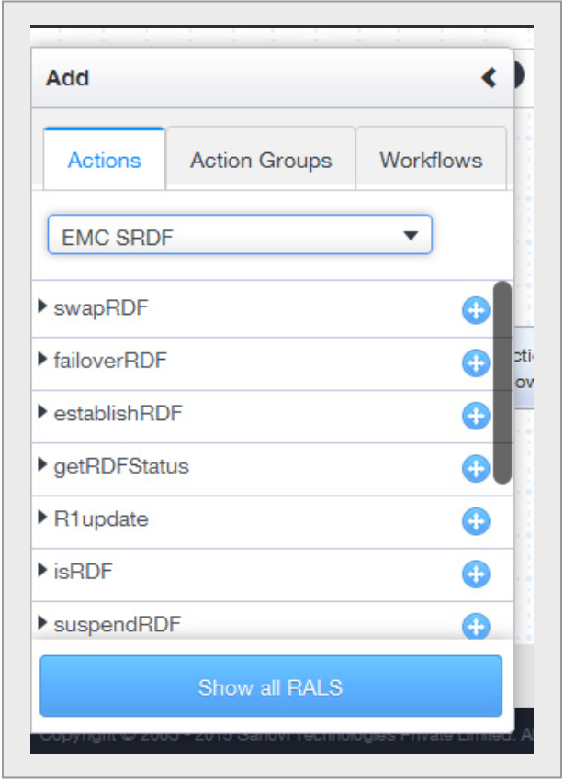
IBM Cloud Resiliency Orchestration
IBM Cloud Resiliency Orchestration provides orchestrated DR testing and failover processes across heterogenous systems.
Reliable, speedy recovery with powerful recovery workflow mechanism and 450+ pre-defined patterns
Business Group
Application Group
Application Group
Functional Group
Functional Group
Functional Group
Functional Group
Functional Group

Slide 19
IBM Cloud Resiliency Orchestration with optional consulting and application and IT discovery services can help transform your DR.
IBM Cloud Resiliency Orchestration
IBM Cloud Resiliency Orchestration Consulting
Orchestration Readiness Assessment: Examines 10 areas essential to orchestration and determines level of readiness to migrate
Application Dependency Analysis: Identify critical application dependencies for recovery/restart workflows and procedures
Resiliency Program Management: Manage development of recovery workflows, test exercise coordination and overall DR program management
Deploy best
practices DR
workflow
Compliance
& deviation
reports
Real-time
RPO & RTO
Automated
application
recovery
“Pre-Flight”
checks
Out-of-box
Switchover
& switchback
IBM Cloud Resiliency Orchestration
The service combines automation and analytics for faster, more cost-effective disaster recovery to help keep daily business operations running and to proactively avoid disruptions.
Offering with managed services
Dashboard to view status
Application and IT Discovery
Cloud Resiliency Application and IT Discovery helps automate the discovery process of logically segmenting the infrastructure.
Multilevel server dependencies
Faster and more accurate than manual grouping techniques

Slide 20
Interested in the new paradigm shift to orchestrated resiliency but not sure if you are ready to migrate?
IBM Cloud Resiliency Orchestration
Resiliency Orchestration Readiness Assessment examines the ten key focus areas essential to orchestration and determines the level of maturity or readiness to migrate
IBM Cloud Resiliency Orchestration Readiness Assessment includes:
Disaster recovery program and policy
Roles and responsibilities
Recovery time and recovery point objectives (RTO/RPO)
Disaster recovery plans and procedures (run books and workflows)
Automation
Replication
IT operations, problem and change management
Testing
Reporting
Dependencies
Applications
IT Infrastructure
Resources
Supply chain
Skills
Data and processing synchronization

Slide 21
Need help to identify critical application interdependencies and to develop recovery/restart workflows?
IBM Cloud Resiliency Orchestration
Application Dependency Analysis maps critical application relationships and interdependencies to enable development of accurate recovery/restart workflows and procedures for orchestrated resiliency
Application Dependency Analysis includes:
Business processes to applications
Application components
Data
Supporting infrastructure
Application-to-application(s)
Application(s)-to-infrastructure
Recovery time and recovery point objectives (RTO/RPO)
Recovery/restart priority
Recovery/restart sequencing and synchronization
Hardware platforms
Operating systems
Databases
Network (LAN/WAN)
Storage
Internal and external
Upstream and downstream processes

Slide 22
Can your DR program help you avoid, prepare for, and respond to disruptions that can impact your critical business services?
IBM Cloud Resiliency Orchestration
IBM Resiliency Program Management reviews and documents your DR technical design, reviews and validates both technical and application recovery/restart workflows and procedures, manages your DR exercises, and keeps it all current and ready for use when needed
Resiliency Program Management includes:
IT recovery requirements review
IT recovery program design
Technical recovery procedures review and verification
Application recovery procedures review and verification
IT recovery exercise management
pre-exercise readiness verification and recovery exercise plans
exercise coordination
post-exercise reviews
Management and maintenance of manual and automated run books

Slide 23
IBM Cloud Resiliency Orchestration with optional consulting and application and IT discovery services can help transform your DR.
IBM Cloud Resiliency Orchestration
IBM Cloud Resiliency Orchestration Consulting
Orchestration Readiness Assessment: Examines 10 areas essential to orchestration and determines level of readiness to migrate
Application Dependency Analysis: Identify critical application dependencies for recovery/restart workflows and procedures
Resiliency Program Management: Manage development of recovery workflows, test exercise coordination and overall DR program management
Deploy best
practices DR
workflow
Compliance
& deviation
reports
Real-time
RPO & RTO
Automated
application
recovery
“Pre-Flight”
checks
Out-of-box
Switchover
& switchback
IBM Cloud Resiliency Orchestration
The service combines automation and analytics for faster, more cost-effective disaster recovery to help keep daily business operations running and to proactively avoid disruptions.
Offering with managed services
Dashboard to view status
Application and IT Discovery
Cloud Resiliency Application and IT Discovery helps automate the discovery process of logically segmenting the infrastructure.
Multilevel server dependencies
Faster and more accurate than manual grouping techniques

Slide 24


IBM Cloud Resiliency Orchestration
IBM Cloud Resiliency Application and IT Discovery for Orchestration
Helps identify and map business applications to the IT infrastructure
Speed up, simplify and scale up DR automation using IBM IT Dependency Mapping:
Map server dependencies and software currencies
Reflect the discovery into Cloud Resiliency Orchestration
Simplify IT discovery unobtrusively
Scalable and quick discovery - medium to very large computing environments’ discovery can be achieved in as little as 6-10 weeks.
Notes:
Images to be checked
Without a clear view of their business applications clients are concerned their DR environment may not function properly when required
Risk mitigation, unplanned service outages and disruption to the business is our client’s primary concern.
IBM Cloud Resiliency Application Dependency Mapping uses technology built by IBM Research to provide a quick and unobtrusive way to map business applications

Slide 25
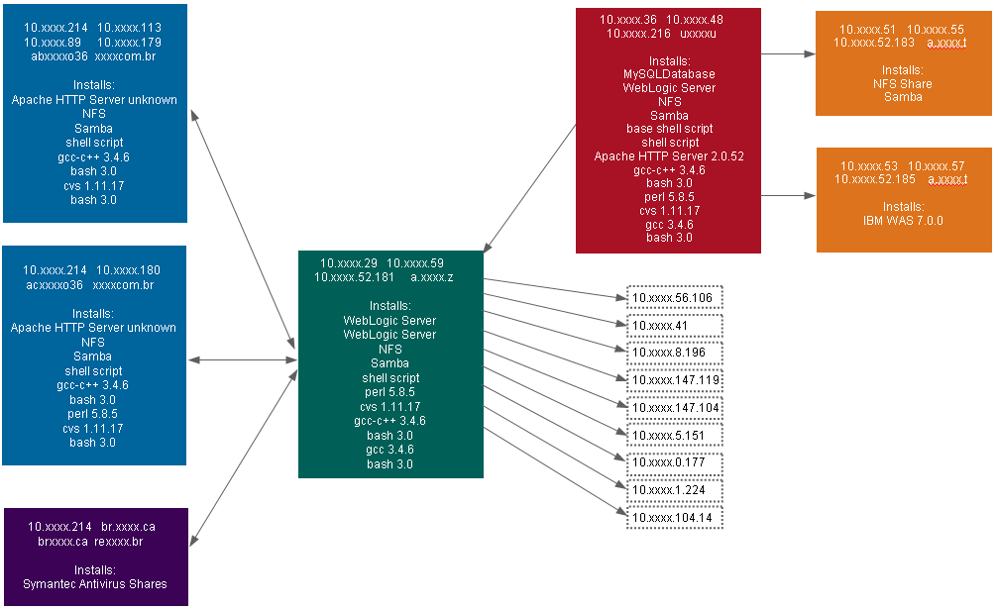
IBM Cloud Resiliency Orchestration
IBM Cloud Resiliency Application and IT Discovery for Orchestration Multilevel dependency mapping
Automate the discovery process of logically segmenting the infrastructure
Four levels of mapped dependencies
Example: ● Web ● Application ● Database ● File Share/WebSphere
Multilevel server dependencies
Maps the end-to-end chain of dependencies
Based on user-defined criteria, usually server-to-application mapping
Automatically creates infrastructure grouping scenarios
Faster and more accurate than manual grouping techniques
Simplifies mapping of large numbers of servers, which are too difficult to map manually
Maps orphan servers, which are sometimes overlooked
Helps to ensure all dependent infrastructure elements are migrated efficiently to support application needs

Slide 26


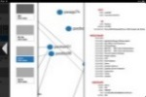
IBM Cloud Resiliency Application and IT Discovery for Orchestration – architecture
IBM Cloud Resiliency Orchestration
Infinitely scalable cloud computing platform makes advanced analytics possible, in a timely convenient manner with the security assurances of IBM Cloud technology.
IBM Cloud
RHEL 64 bit / XEN Virtual instance
Firewall
GUI
Analytics engine
Data repository
Visualization engine
IBM
Firewall
CLIENT PREMISE
User platform
Web Portal
Data modeler
Data (.csv)
Resource utilization trending
Server Visualization
Notes:
Change to the color

Slide 27
IBM Cloud Resiliency Orchestration
How IBM Cloud Resiliency Application and IT Discovery helps
Do you know where business applications and components are installed and the associated dependencies before before you embark any IT projects including data center migrations and DR assessments ?
IBM Cloud Resiliency Application and IT Discovery for Orchestration helps to discover and map business applications to the IT infrastructure
Do you have the time or resources to engage in a complete application mapping exercise?
IBM Cloud Resiliency Application and IT Discovery for Orchestration can typically be completed in 8 – 12 weeks with a scope of 30 mapped applications and 1,000 servers
Do you need to deploy tools on IT Infrastructure ? How about IT security?
IBM Cloud Resiliency Application and IT Discovery for Orchestration requires that only a simple script be run on the servers typically for 5 days. No enterprise level tools are deployed, no firewall rules are changed and no credentials are provided to IBM.

Slide 28
IBM Cloud Resiliency Orchestration
Pricing Model – IBM Cloud Resiliency Orchestration
Primary DC | DR- DC | Can be delivered with
Customer/IBM/AWS/IBM Cloud | Customer/IBM/AWS/IBM Cloud | Any DC to any DC
IBM deliverables: based on scope agreed with customer
Orchestration proxy server at primary site
Orchestration server at DR site
Right to use (subscription) license for Resiliency Orchestration tool
Virtual machines
Bare metal machines
Implementation services
Program manager to manage Project
Customer operation team training
DR tests
Monitoring and managed services for tool and orchestration server if provided by IBM
Consultant – for creating runbooks and workflows
Optional services:
Application and IT Discovery for Orchestration
Orchestration Consulting
Pricing Model:
One-time implementation: OTC
Monthly recurring charges: MRC
Prices include:
Orchestration scope defined in contract
Additional charges for
Optional Charges:
Orchestration Consulting
Application and IT Discovery

Slide 29

For more information
IBM Cloud Resiliency Orchestration
Visit Website
Deploy best
practices DR
workflow
Compliance
& deviation
reports
Real-time
RPO & RTO
Automated
application
recovery
“Pre-Flight”
checks
Out-of-box
Switchover
& switchback
IBM Cloud Resiliency Orchestration Video

